Slide 1
Research leader or entrepreneur?
Researcher Education and Development Conference 2015
The University of Sheffield
Friday 18th September 2015
Natacha Wilson Research and Education consultant
Director Cambridge Insights Ltd
Notes:
The purpose of this presentation is to look at the importance of entrepreneurial skills in developing aspiring research leaders (postdocs) and the implications for researcher development
engage at PhD stage,
embed entrepreneurial skills
apply to context and discipline
The paper will also argue that researchers should think of themselves as “intellectual” entrepreneurs and focus on three key areas: develop a vision for their research, work on a plan to carry out that vision, and seek the funding to make it happen. (this about nature and traits??? Key ones are resilience, drive, self efficacy but can I show a link with other research?)

Slide 2
Approach
Mentoring Entrepreneurs
Start-up experience
Research in entrepreneurial leadership education
Navigating the hairpin
University of Cambridge
Notes:
My approach and
Parallel thinking
The lens approach
General definition of entrepreneurship is
“ The pursuit of opportunity beyond the resources one currently controls (Stevenson and Gumpert, 1985)

Slide 3
Becoming a Principal Investigator(PI): the transition from doing to leading research
Researching how researchers
prepare for the transition and
deal with the significant ‘leadership transition’ to becoming a Principal Investigator and gain research independence
Interviews with 46 PIs from the University of Cambridge and Leiden university – across disciplines
Research team
Dr Sharon Saunders - University of Cambridge
Professor Lynn McAlpine – University of Oxford
Natacha Wilson – Cambridge Insights
Notes:
About the project: Becoming a Principal Investigator (PI): the transition from doing to leading research is a research project funded by The Elsevier Foundation New Scholars Programme http://www.elsevierfoundation.org/new-scholars/ the University of Cambridge and Leiden University. Ethical approval was granted by the University of Cambridge on the 20th January 2014.
Principal goals of the research:
to find out how researchers prepare for and deal with the significant ‘leadership transition’ to becoming a Principal Investigator and gain research independence. The research specifically looks at the time period from when researchers started their PhD to obtaining their first substantial grant as PI. to develop resources to support the personal, professional and career development of postdoctoral researchers (ii) to provide evidence to inform researcher and educational development policy and practice.
:Project rationale: Globally, the number of postdoctoral researchers is increasing and the length of the postdoctoral period is lengthening. The postdoctoral period is when individuals are expected to further develop their scholarly independence, their scholarly identity and their academic career trajectory yet their experiences of gaining a permanent position in academia are relatively under-examined. There is also little evidence on which to base changes in policy and practice in order to facilitate their advancement.
Project methodology: Three research intensive Universities are participating in the research study: University of Cambridge and Imperial College London in the UK Leiden University in the Netherlands. Data are being collected at an individual level through the in-depth interview method and at an institutional level using a template in order to capture the policies, funding and professional and career development support offered.
Who’s involved?: Dr Sharon Saunders is the project leader and is joined by Professor Lynn McAlpine, Professor of Higher Education Development at the University of Oxford and Professor Emerita at McGill University and Natacha Wilson, Research Associate and Director of Cambridge Insights a learning and innovation consultancy

Slide 4
Research leaders’ focus (I)
Develop vision for research
Plan
Seek funding
Notes:
Researchers should see themselves as “intellectual” entrepreneurs and focus on three key areas: develop a vision for their research, work on a plan to carry out that vision, and seek the funding to make it happen.
Hypothesis on reality of research leader’s focus
Step by step approach? No – see next slide

Slide 5
Research leaders’ focus (II)
Develop vision for research
Plan
Seek funding
Notes:
Reality – intertwined activities and process starts at PHD!!

Slide 6
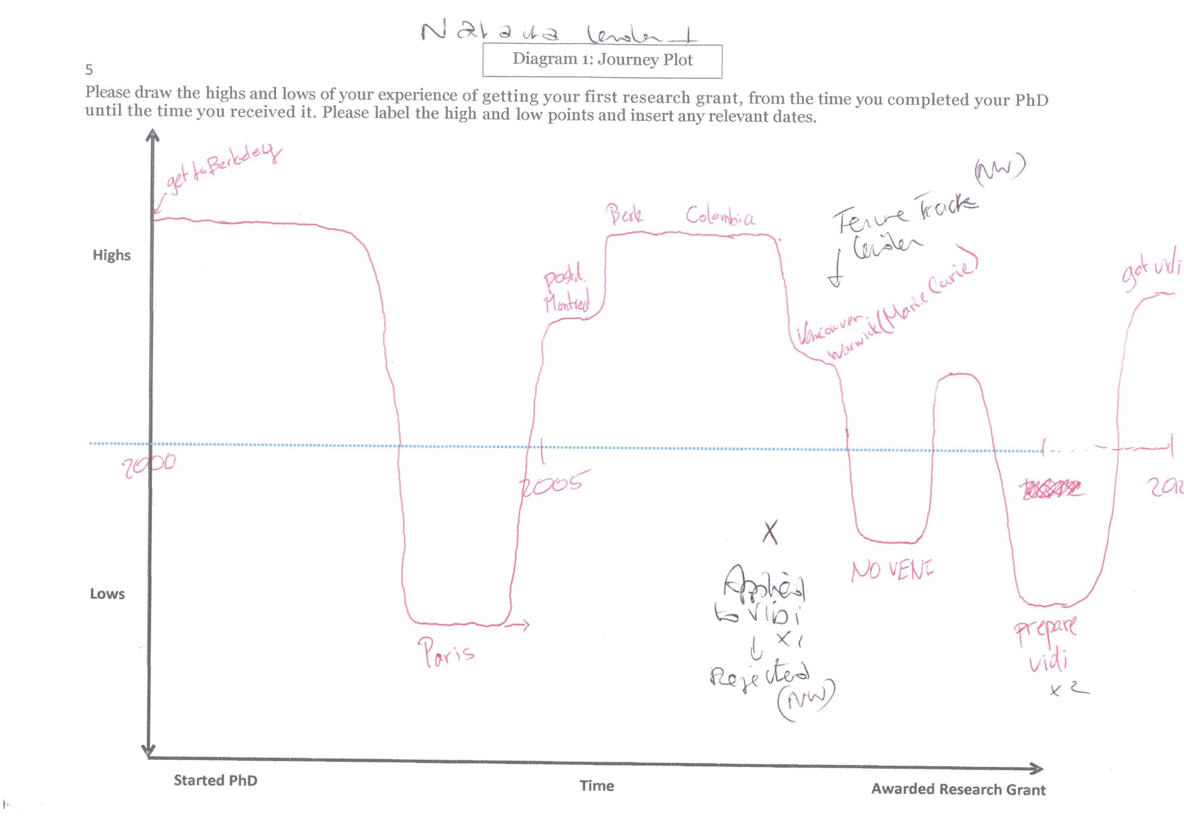
The journey
Notes:
Similarities with entrepreneurs

Slide 7
Successful research leaders and entrepreneurs
Nature or nurture
Luck factor
Hard work
Taking risks
Other (traits and skills)
Resilience (overcoming challenges) and self-efficacy
Drive – willingness to succeed
Risk Taking
Understanding environment
Building networks
Notes:
Cogliser and Brigham (2004) - The intersection of leadership and entrepreneurship: Mutual lessons to be learned
Dowd, K., & Kaplan., D. (2005). The career life of academics: Boundaried or boundaryless?
Talk about hairpin results so far.

Slide 8
Entrepreneurial skills
Conceptual overlap between entrepreneurship and leadership:
Cogliser and Brigham (2004) identified 4 common areas:
Vision
Influence
Leadership of innovative/creative people
Planning
Fernald et al. (2005) identified key characteristics for entrepreneurial leadership
Vision
Problem-solving
Decision –making
Risk-taking
Strategic initiatives

Slide 9
Implications for Researcher Development
Where does entrepreneurial learning fit in? (RD focus vs add-on)
When should this start? (PhD, Postdoc, PI)
What should be covered?
Which approach and methods should be offered to develop entrepreneurship skills?
How do we evaluate this?
Notes:
Research on entrepreneurship education has developed considerably in recent years

Slide 10
Thank you.
Feedback and questions to
natachawilson@cambridgeinsights.co.uk

